Slide 1
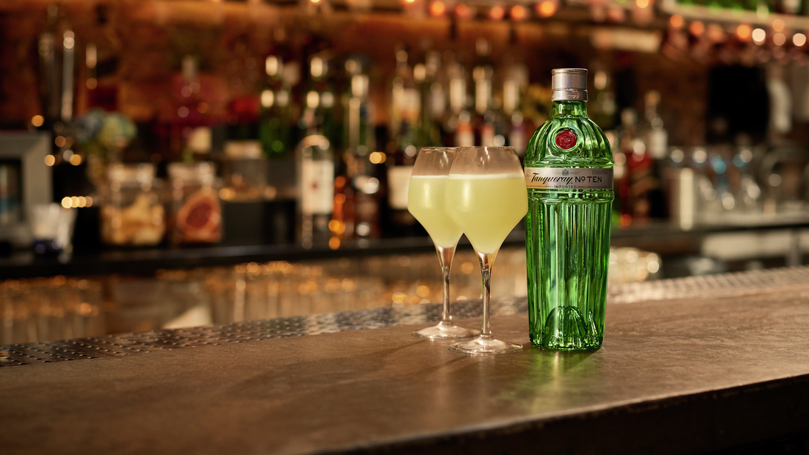
Agent Based Modeling
With Mu Sigma
May 3, 2019
Prepared by Karen Chisholm and Adam Ben-Yousef

Slide 2

Scope
Australia market (to be confirmed)
Create a catalog of services that help us answer questions about consumers, with a focus on gen Z drinking habits or some other consumer cohort
E.g. what are the possible futures and what impact would that have on our business
E.g. what if, consumers reduced the frequency they went out. What impact would that have on our categories
What are the conditions that lead to seismic shifts in the drinks market in
which one category starts to grow and take share from others?
How can Diageo spot such shifts early so that it is able to capitalise on them?
You can help write the questions

Slide 3
Australia thoughts
Some thoughts from me on this, I won’t join the call this evenjng. This is a potential game changer. From a global Diageo, global CPG and Aus customer POV we can lead the way as best performing. Tech & pharma + some advanced CPGs are already playing in this space with others to follow suit soon no doubt.
In essence the model projects the sales impact of consumer behaviour and cultural change. It’s total category not just brands, as such leveraged for brand and portfolio planning. We could generate category insights for our customers no other competitor would have. We could seek to understand:
1. What if population growth continues at ~2% PA driven by cap cities with a 50/50 mix of organic to immigration?
2. What if 15% of evening occasions cease to exist with a further 15% shifting to early afternoon?
3. What if online alcohol sales grow at 5% PA?
4. What if Bundys penetration grown rate trails behind competitors Jim/Jack/CC by 30%?
5. What if the Diageo portfolio increased its talkability/buzz of its brands 2x over as many years.
6. What if Bundy salience trajectory continues to decline at 1% PA?
7. Additionally this should connect the dots between penetration and volume considering all the macro inputs that drive this relationship ethnicity mix / per capita etc.
Page 3

Slide 4
Agent based modeling
Diageo has identified AgentBased Modelling (ABM) as a promising approach to the challenge of understanding the underlying drivers of major shifts in the drinks market.
AgentBased Modelling differs from conventional analytical and modelling techniques used in marketing in a number of important respects. It complements existing techniques, and helps marketers to answer different, but relevant, questions:
ABM focuses on the behavioral and environmental drivers of the patterns that we see in aggregate data, so we have a chance to understand the causes of trends, not just to spot them.
It looks at the total market, not just focusing on one brand or company, and so is able to capture the effects of changes in one brand or subcategory on another.
It looks at the effects of things that are not under the marketer’s control, such as changes in population demographics or policy impacts, as well as those that are.
It is an individual-based technique, and as such is able to capture the differences in response amongst consumers across the market: not only in terms of differences driven by demographic characteristics, but also differences in preference and behaviour.
It can capture differences or changes in behavior amongst different geographically located portions of the population.
ABM is a simulation based (what if …)
Page 4

Slide 5
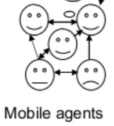

High Level plan
Months
1
2
3
4
5
6
7
Governance Defined
Start-up
NDA Signed
5
9
SOW Signed
Diageo Access
New SOW for Scale to Production
Proof of Concept
Proof of Concept (3 months)
Proof of Concept and assessment of existing infrastructure
Consumer-level agent causal model
kickoff
Data Discovery
Design Workshops
Scale to Production
Approval
Scale to Production (3 months)
Page 5

Slide 6
Causal Model & Simulation
Deliverable | Proof of Concept: Construct consumer-level agent causal model and validate simulation against macro-level indicators for the US market
Design Model
Conduct a data audit and secure data. Confirm business questions
Build Model
Run simulations and conduct macro/micro validation
Test Model
Package final deliverable answering the question “Were we able to simulate consumer behavior accurately and identify causal effects in the consumer decision-making mechanism?”
Estimate the initial causal models based on available data sources
Define heuristic priors from existing market research as well as expert opinions
Update causal models
2 iterations and review
Share experiment results
Page 6

Slide 7
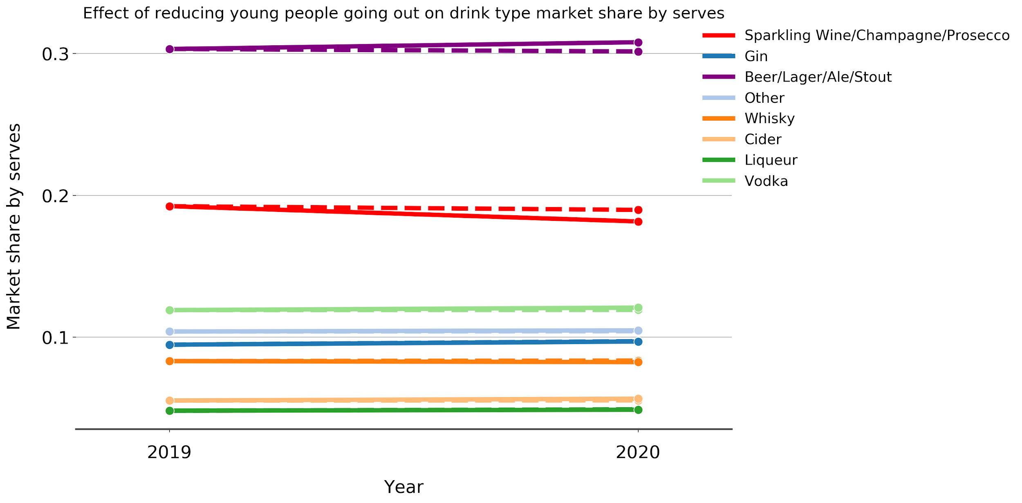
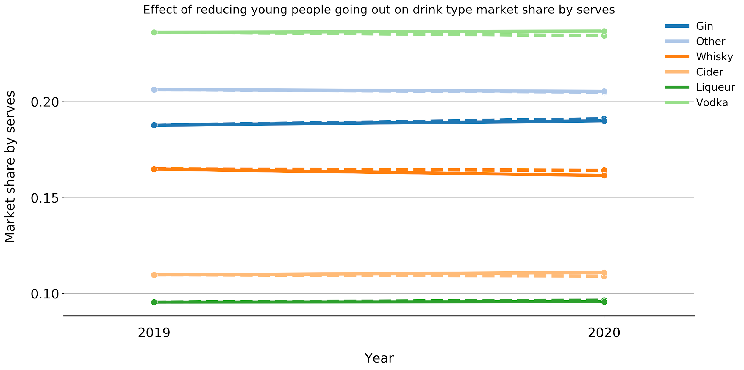
Sample deliverable
illustrative only
Scenario:
Sample Output
When we reduce the likelihood that 18-24 year olds will go out when they drink by 20%, wine decreases 3% and beer increases 2%
When we take out beer and wine, gin increases 1% and whisky decreases 1%
Page 7

Slide 8
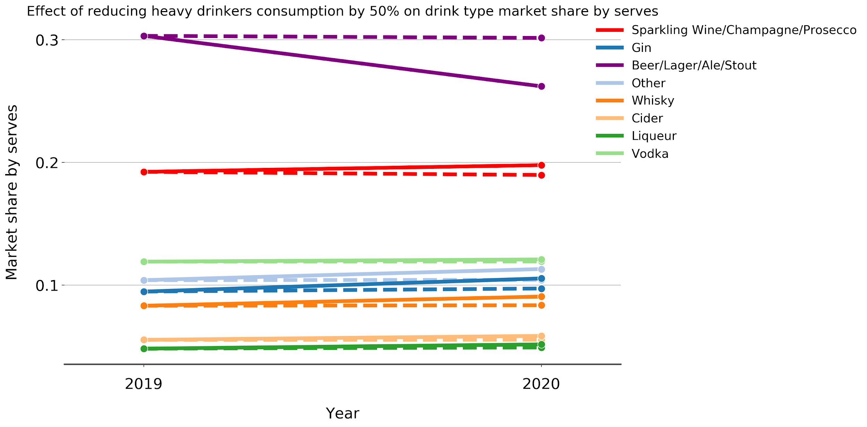
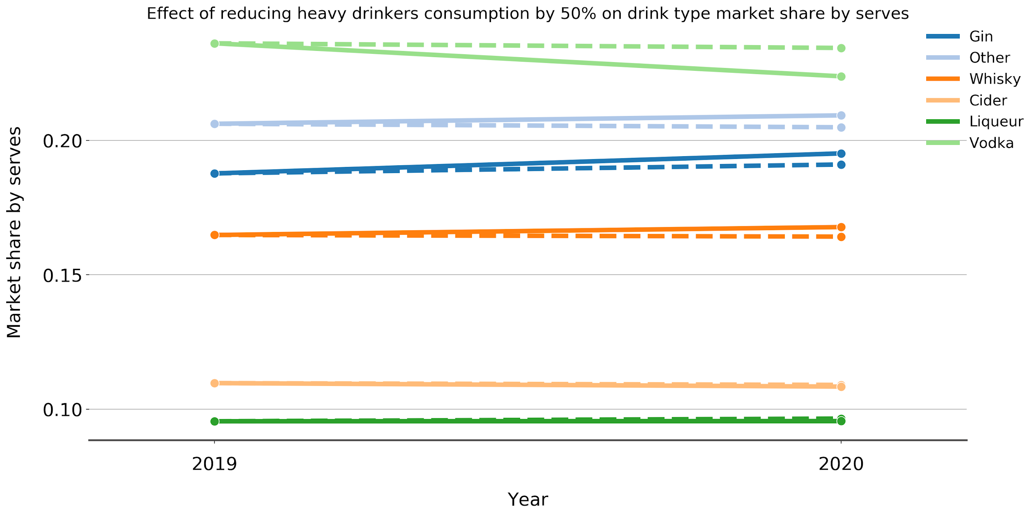
Sample deliverable
illustrative only
Scenario:
Sample Output
When we reduce the volume consumed by heavy drinkers, over the recommended amount, by 50%, beer decreases 13% and wine increases 5% and
When we look at share excl. beer and wine, gin and whisky both increase ~3%, vodka decreases 5%
Page 8

Slide 9
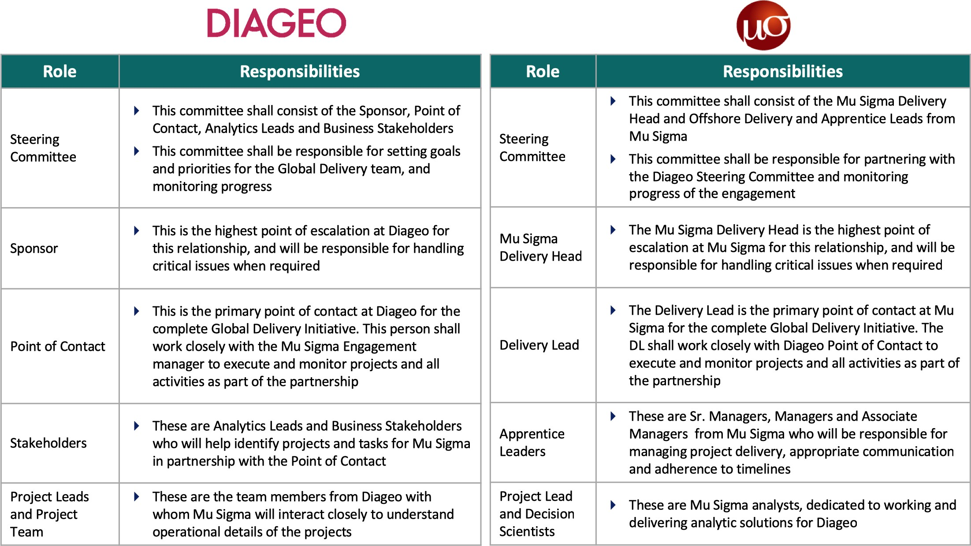
Roles & Responsibilities
Page 9

Slide 10
Diageo Roles & Responsibilities
Role | Who | Company | Location | Responsibilities
Sponsor | Adam | Diageo | London | *Scope approval * Coordinates executive senior stakeholders * Business view: Develops and maintains the holistic vision and roadmap for advanced analytics
Project Lead | Karen | Diageo | NYC | * Manages overall timelines, financials, procurement, status reporting, overall resourcing * Agree project scope, methodology and governance model with governance manager and key stakeholders * Point of contact for Risk and Issues that cannot be resolved within the team
Product Lead | Brian Prascak | Diageo | Norwalk CT | * Provides expert advice on methodology and approach * Sources data required for the project * Vets all Mu-Sigma resources
Key Stakeholder | Thomas Grace | Diageo | Sydney, Australia | * Recommends scope for project * Provides guidance during project setup * Ensures project delivers value and answers valuable projects
Supporting Stakeholder | Rob Sinclair | Diageo | Norwalk CT | * Provides expert advice on Diageo business, advanced analytics
Data Scientist | Gerry Pollak | Diageo | Norwalk CT | * Provides expert advice on methodology and approach
Page 10

